Slide 1
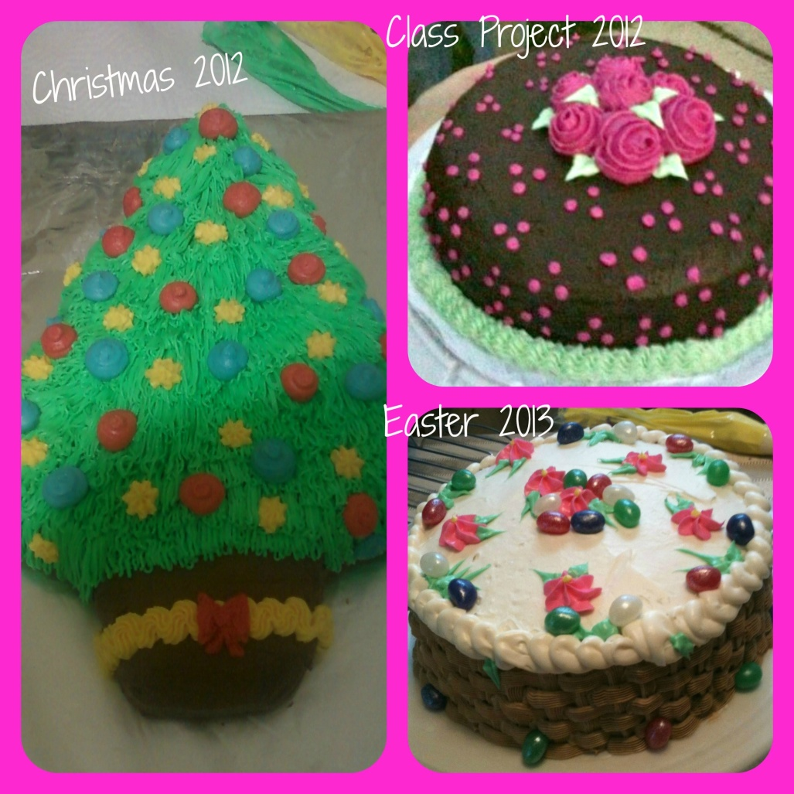
Cake Decorator and Baker
Caitlin Beirne
May 3, 2013
3rd Hour
Career Technology

Slide 2
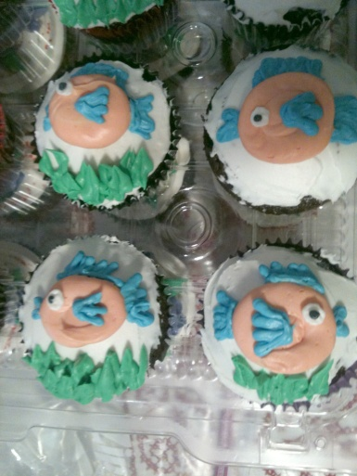
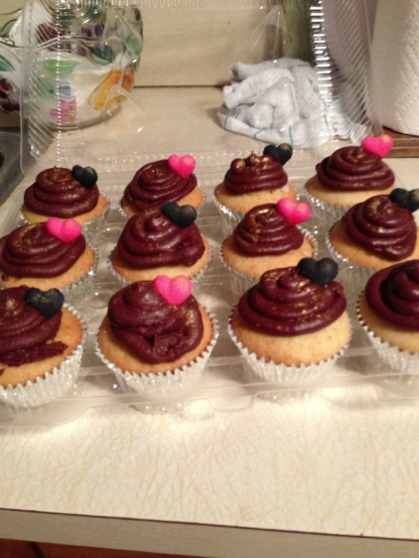
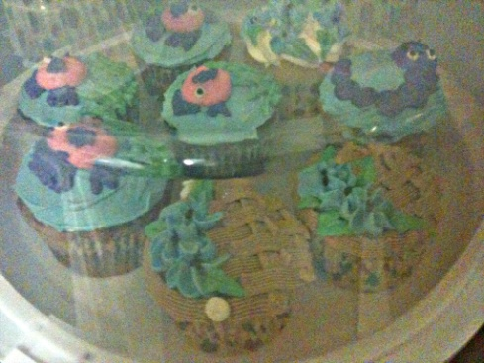
Introduction
“Baking cookies is comforting, and cookies are the sweetest little bit of comfort food. They are very bit-sized and personal.” ~Sandra Lee. Baking is really comforting to me. Baking and decorating is so much fun. I got into cake decorating and baking from watching T.V.. I use to watch T.V. all the time and I would watch Cake Boss, Ace of Cakes, and Cupcake Wars. I loved how talented everyone was. My Aunt Terie and I used to bake all the time and I wanted my desserts to be like theirs. In order to get a better understanding of my career as a cake decorator, I will be researching the nature of the work, working conditions, training, qualifications, advancement, job outlook/employments, earnings, and a related occupation.

Slide 3
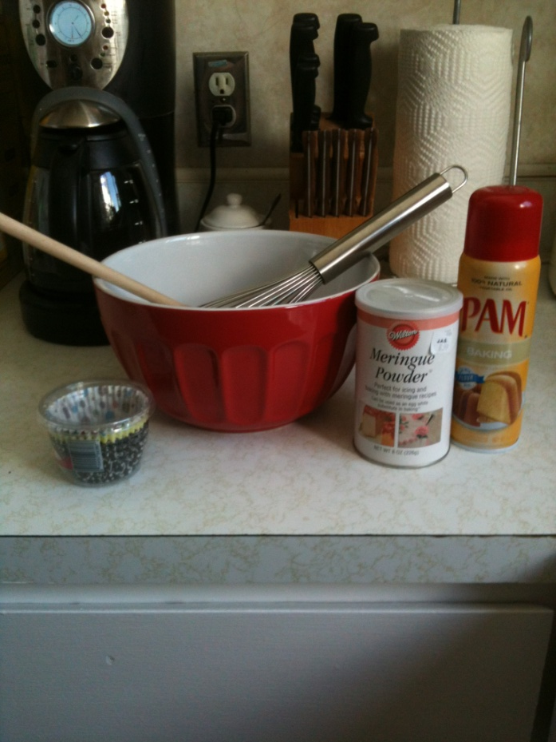
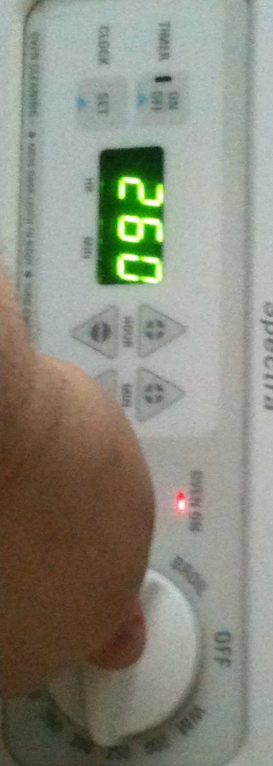
Nature of Work
Check the quality of ingredients
Prepare equipment for baking
Knead, roll, cut, and shape dough
Set oven temperatures
Apply glazes, icings, or other toppings using spatulas or brushes

Slide 4
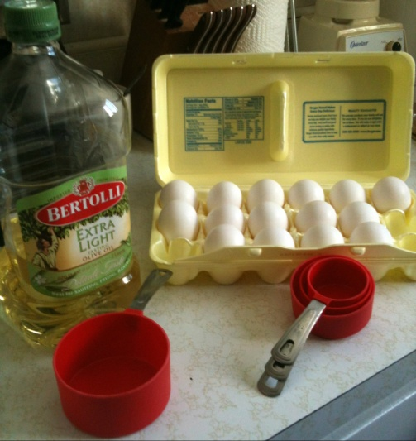
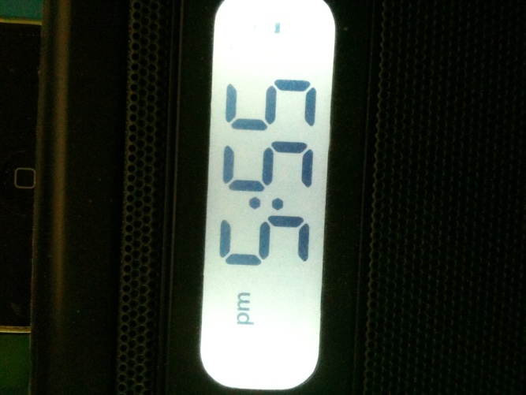
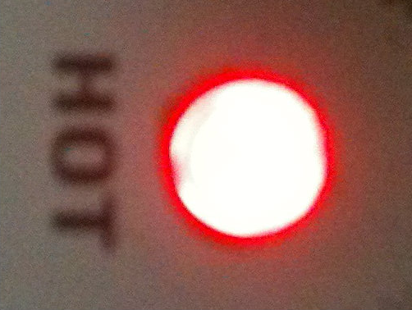
Working Conditions
Physical: need strength to carry materials and knead dough
Mental: need to know the ingredients
Indoor: bugs outdoors, ovens and materials indoors
Hours: 72% full time and 28% part time; work early mornings, late evenings, holidays, and weekends
Conditions: bakeries are hot and loud, injuries occur more than average, stressful

Slide 5
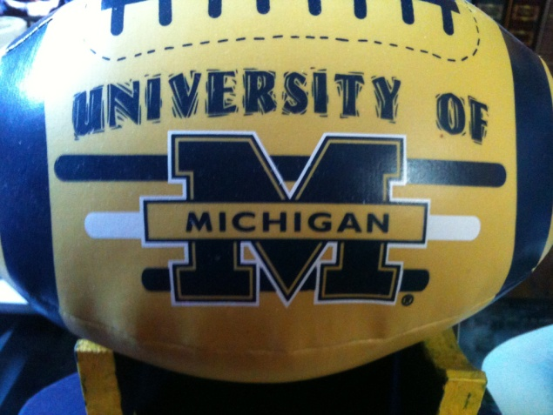
Training, Qualification, Advancement
No real education required
Start by attending a technical or culinary school or through an apprenticeship
Where I want to go: The Art Institutes in Novi for culinary skills
Where I want to go: The University of Michigan for business studies
High School classes to take:
722A/B/C Hosp/Culinary| Roseville
723A/B/C Hosp/Culinary || Roseville
602X Business Law TC

Slide 6
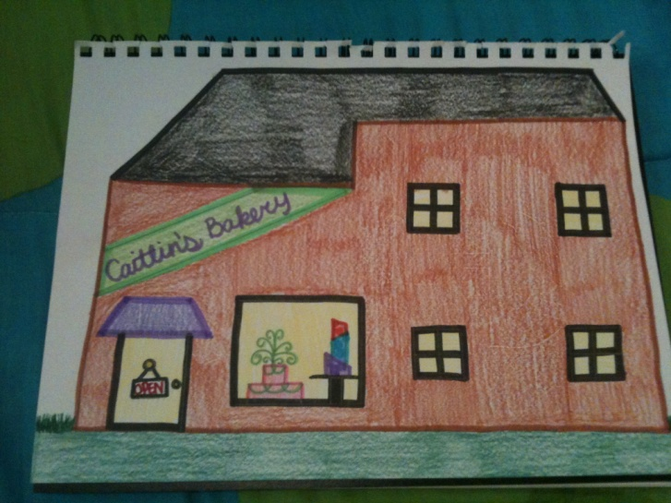
Job Outlook/Employment
Employment rate: rise 2%
Find a job: in Saint Clair Shores
Competitive?: The better the baker, the better the chance of finding a job
Where?: Want to own a bakery; until then, anywhere

Slide 7
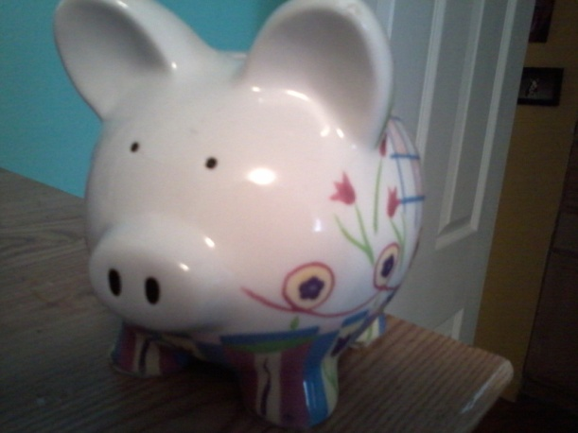
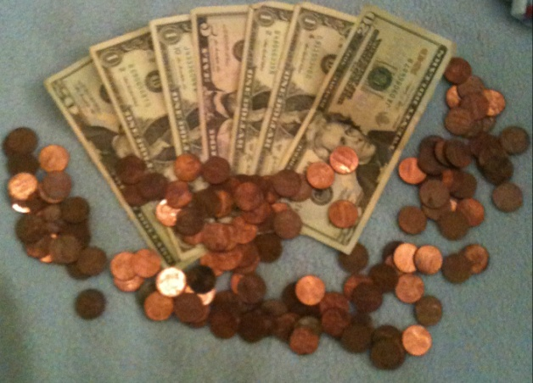
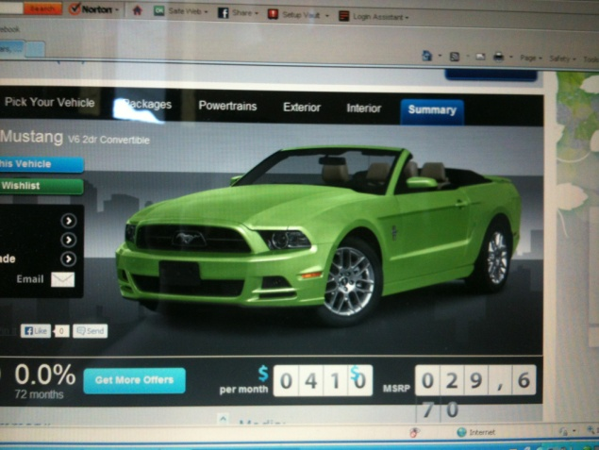
Earnings
Earnings: (depends where you work) on average $23,450 per year
Lifestyle goal #1: Live in a two story house; about $185,000(-)
Lifestyle goal #2: Drive a Ford Mustang; about $29,670(-)
Lifestyle goal #3: Own my own bakery; about $500,000(-)
Lifestyle goal #4: Own a boat; about $96,878(-)

Slide 8
High School Math Teacher
Responsibilities:
1)Plan lessons in the subjects they teach
2)Assess students to evaluate their abilities, strengths, and weaknesses
Where?: Public, charter, secular or religious schools
Hours: Work 10 months with a 2 month break or year-round, 8 weeks at a time with 1 week breaks and 5-week midwinter break
Why did I choose this?: love math and helping others

Slide 9
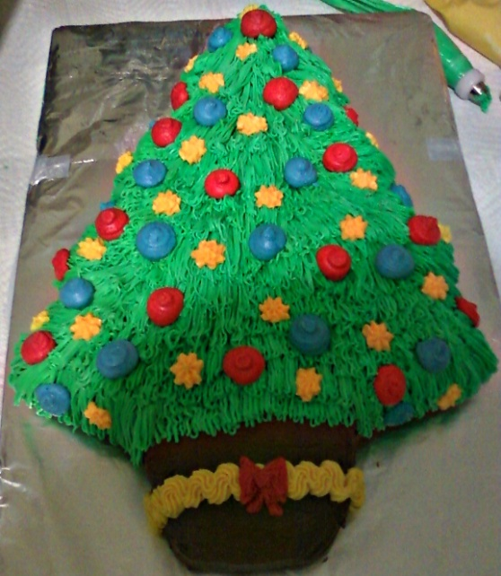
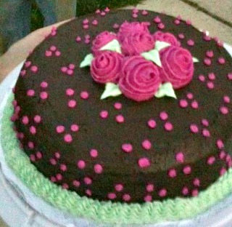
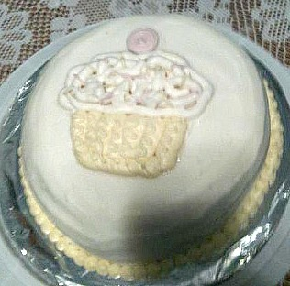
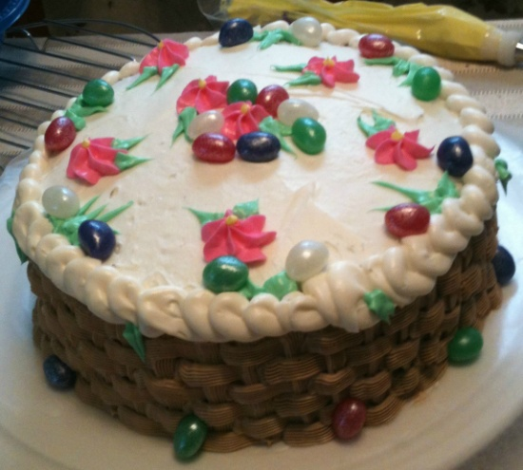
Summary
I don’t care how much I’ll make or where I’ll have to go to work. I love cake decorating and baking. As long as I do what I love, I don’t care what I make. I am looking forward to having fun and hopefully owning my own bakery. I am not looking forward to such a low pay, but that can possibly be changed. I have learned that I will probably have to change my wants to be able to own my own bakery. I’ve learned that I can still go to the University of Michigan to get educated for owning a bakery.

Slide 10
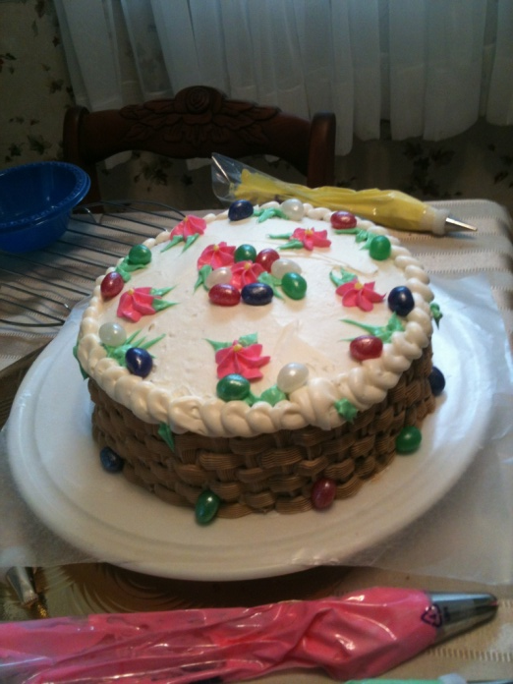
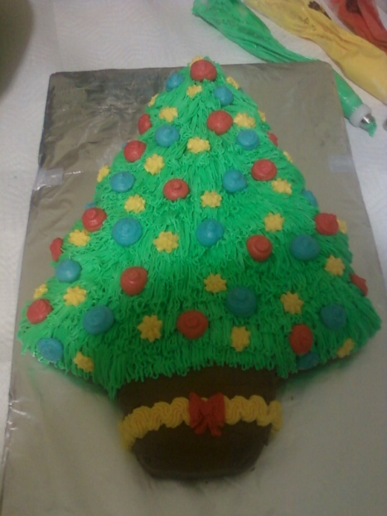
Citations
http://boats.iboats.com/new-cuddy-cabin-boats-michigan/n1c200009i41/
http://www.bls.gov/ooh/production/bakers.htm#tab-1
http://www.bls.gov/ooh/education-training-and-library/high-school-teachers.htm
http://www.royobrien.com/build-and-price/configuration/ec059beff708dfd556ed9a8bfb3325d6
http://www.realtor.com/realestateandhomes-search/48082
http://www.chef2chef.net/culinary-institute/state/michigan-culinary-schools.htm
http://www.umich.edu/units.php
http://www.lakeshoreschools.org/lakeshore/docs/CourseOfferingsUpperclassmen.pdf

